Slide 1
Singular Value Decomposition
COS 323

Slide 2
Underconstrained Least Squares
What if you have fewer data points than parameters in your function?
  Intuitively, can’t do standard least squares
  Recall that solution takes the form A^{T}Ax = A^{T}b
  When A has more columns than rows,
  A^{T}A is singular: can’t take its inverse, etc.

Slide 3
Underconstrained Least Squares
More subtle version: more data points than unknowns, but data poorly constrains function
Example: fitting to y=ax²+bx+c

Slide 4
Underconstrained Least Squares
Problem: if problem very close to singular, roundoff error can have a huge effect
  Even on “well-determined” values!
Can detect this:
  Uncertainty proportional to covariance C = (A^{T}A)⁻¹
  In other words, unstable if A^{T}A has small values
  More precisely, care if x^{T}(A^{T}A)x is small for any x
Idea: if part of solution unstable, set answer to 0
  Avoid corrupting good parts of answer

Slide 5
Singular Value Decomposition (SVD)
Handy mathematical technique that has application to many problems
Given any m×n matrix A, algorithm to find matrices U, V, and W such that
  A = U W V^{T}
  U is m×n and orthonormal
  W is n×n and diagonal
  V is n×n and orthonormal

Slide 6
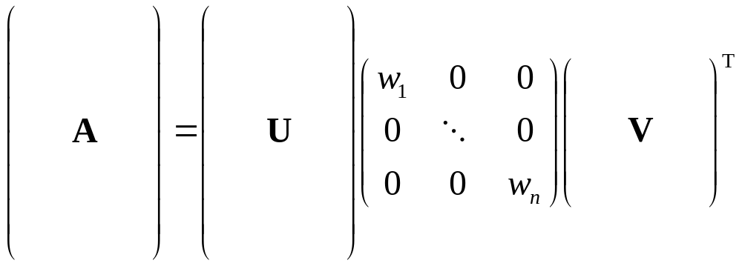
SVD
Treat as black box: code widely available
In Matlab: [U,W,V]=svd(A,0)

Slide 7
SVD
The w_{i} are called the singular values of A
If A is singular, some of the w_{i} will be 0
In general rank(A) = number of nonzero w_{i}
SVD is mostly unique (up to permutation of singular values, or if some w_{i} are equal)

Slide 8
SVD and Inverses
Why is SVD so useful?
Application #1: inverses
A⁻¹=(V^{T})⁻¹ W⁻¹ U⁻¹ = V W⁻¹ U^{T}
  Using fact that inverse = transpose
  for orthogonal matrices
  Since W is diagonal, W⁻¹ also diagonal with reciprocals of entries of W

Slide 9
SVD and Inverses
A⁻¹=(V^{T})⁻¹ W⁻¹ U⁻¹ = V W⁻¹ U^{T}
This fails when some w_{i} are 0
  It’s supposed to fail – singular matrix
Pseudoinverse: if w_{i}=0, set 1/w_{i} to 0 (!)
  “Closest” matrix to inverse
  Defined for all (even non-square, singular, etc.) matrices
  Equal to (A^{T}A)⁻¹A^{T} if A^{T}A invertible

Slide 10
SVD and Least Squares
Solving Ax=b by least squares
x=pseudoinverse(A) times b
Compute pseudoinverse using SVD
  Lets you see if data is singular
  Even if not singular, ratio of max to min singular values (condition number) tells you how stable the solution will be
  Set 1/w_{i} to 0 if w_{i} is small (even if not exactly 0)

Slide 11
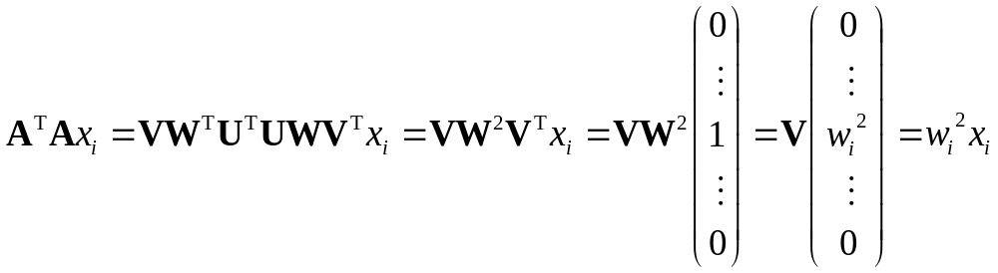
SVD and Eigenvectors
Let A=UWV^{T}, and let x_{i} be i^{th} column of V
Consider A^{T}A x_{i}:
So elements of W are sqrt(eigenvalues) and columns of V are eigenvectors of A^{T}A
  What we wanted for robust least squares fitting!

Slide 12
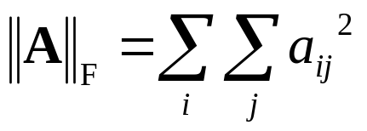
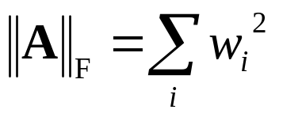
SVD and Matrix Similarity
One common definition for the norm of a matrix is the Frobenius norm:
Frobenius norm can be computed from SVD
So changes to a matrix can be evaluated by looking at changes to singular values

Slide 13
SVD and Matrix Similarity
Suppose you want to find best rank-k approximation to A
Answer: set all but the largest k singular values to zero
Can form compact representation by eliminating columns of U and V corresponding to zeroed w_{i}

Slide 14
SVD and PCA
Principal Components Analysis (PCA): approximating a high-dimensional data set
with a lower-dimensional subspace
*
*
Second principal component
*
*
First principal component
*
*
*
*
*
*
*
*
*
Original axes
*
*
*
*
*
*
*
*
*
*
*
Data points

Slide 15
SVD and PCA
Data matrix with points as rows, take SVD
  Subtract out mean (“whitening”)
Columns of V_{k} are principal components
Value of w_{i} gives importance of each component

Slide 16
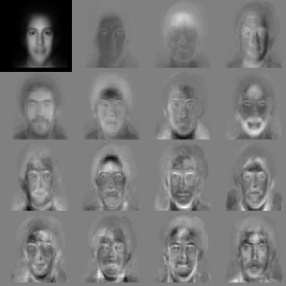
PCA on Faces: “Eigenfaces”
First principal component
Average
face
Other
components
For all except average,
“gray” = 0,
“white” > 0,
“black” < 0

Slide 17

Using PCA for Recognition
Store each person as coefficients of projection onto first few principal components
Compute projections of target image, compare to database (“nearest neighbor classifier”)

Slide 18
Total Least Squares
One final least squares application
Fitting a line: vertical vs. perpendicular error

Slide 19
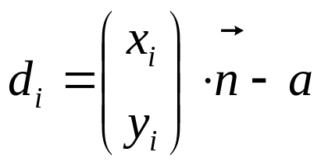
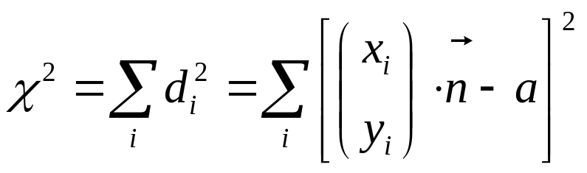
Total Least Squares
Distance from point to line:
where n is normal vector to line, a is a constant
Minimize:

Slide 20
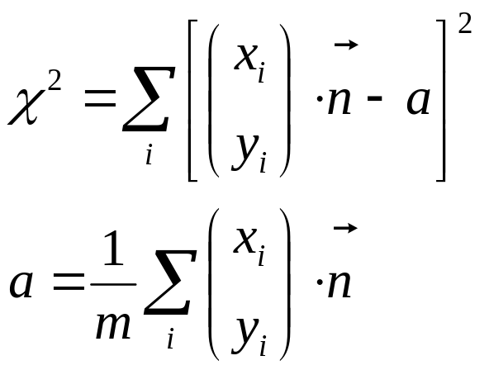
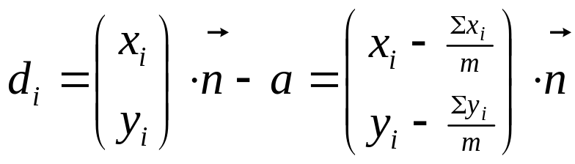
Total Least Squares
First, let’s pretend we know n, solve for a
Then

Slide 21
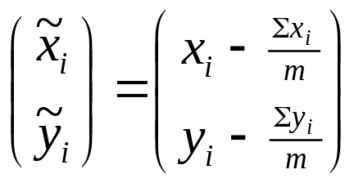
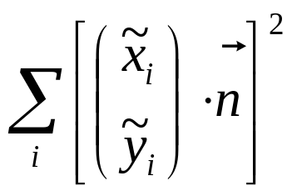
Total Least Squares
So, let’s define
and minimize

Slide 22
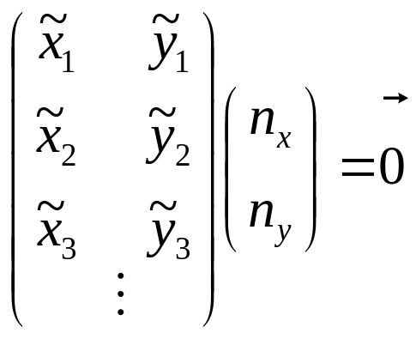
Total Least Squares
Write as linear system
Have An=0
  Problem: lots of n are solutions, including n=0
  Standard least squares will, in fact, return n=0

Slide 23
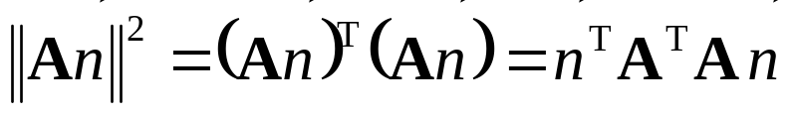
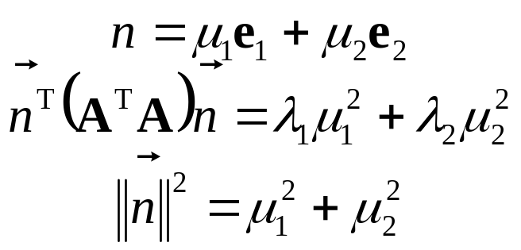
Constrained Optimization
Solution: constrain n to be unit length
So, try to minimize |An|² subject to |n|²=1
Expand in eigenvectors e_{i} of A^{T}A:
where the λ_{i} are eigenvalues of A^{T}A

Slide 24


Constrained Optimization
To minimize subject to
set μ_{min} = 1, all other μ_{i} = 0
That is, n is eigenvector of A^{T}A with
the smallest corresponding eigenvalue

